Slide 1
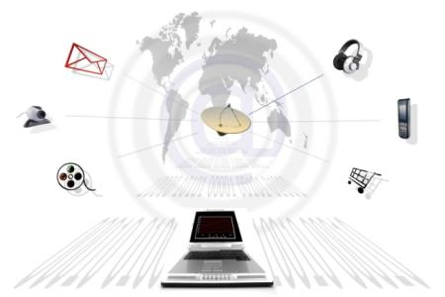
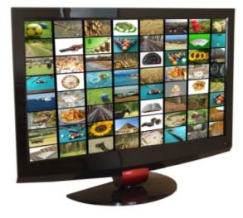
Marketing Communications (promotion)

Slide 2
Learning Goals
Define marketing communications.
Understand the process and goals of integrated marketing communications.
Learn the steps in developing effective marketing communications.
Understand the components of the marketing communication mix

Slide 3
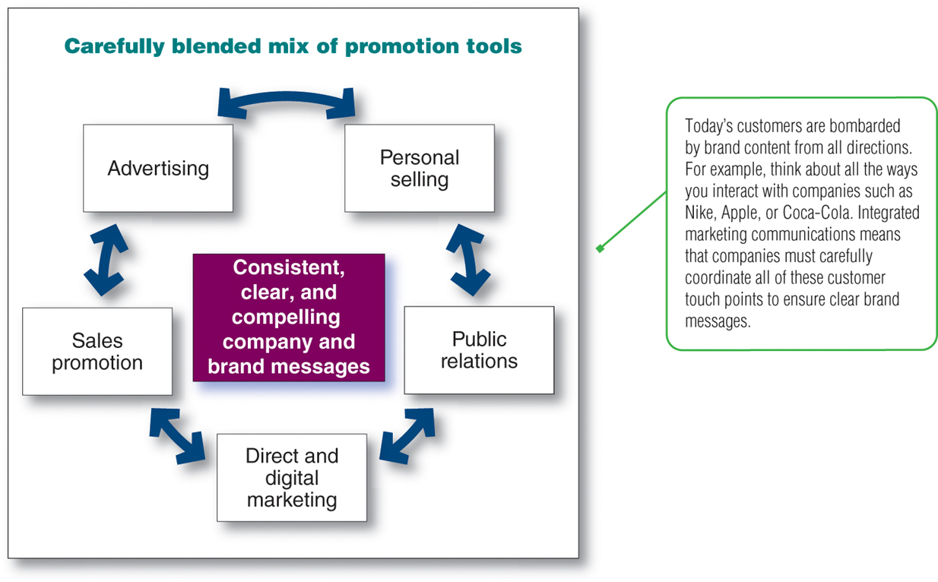
Marketing Communications: The means by which firms attempt to inform, persuade, and remind consumers—directly or indirectly—about the products and brands they sell. In a sense, marketing communications represent the voice of the company and its brands
Integrated Marketing Communications: A planning process designed to assure that all brand contacts received by a customer or prospect for a product, service or organization are relevant to that person and consistent over time. (AMA)
Classical view: Promotion mix
Notes:
The classical view
In marketing, promotion refers to any type of marketing communication used to inform target audiences of the relative merits of a good, service, brand or issue, most of the time persuasive in nature. The aim of promotion is to increase awareness, create interest, generate sales or create brand loyalty.
According to the Association of National Advertisers (ANA), promotion marketing includes tactics that encourage short-term purchase, influence trial and quantity of purchase, and are very measurable in volume, share and profit. Examples include coupons, sweepstakes, rebates, premiums, special packaging, cause-related marketing and licensing. [2] That is why promotion is now more about sales promotion

Slide 4
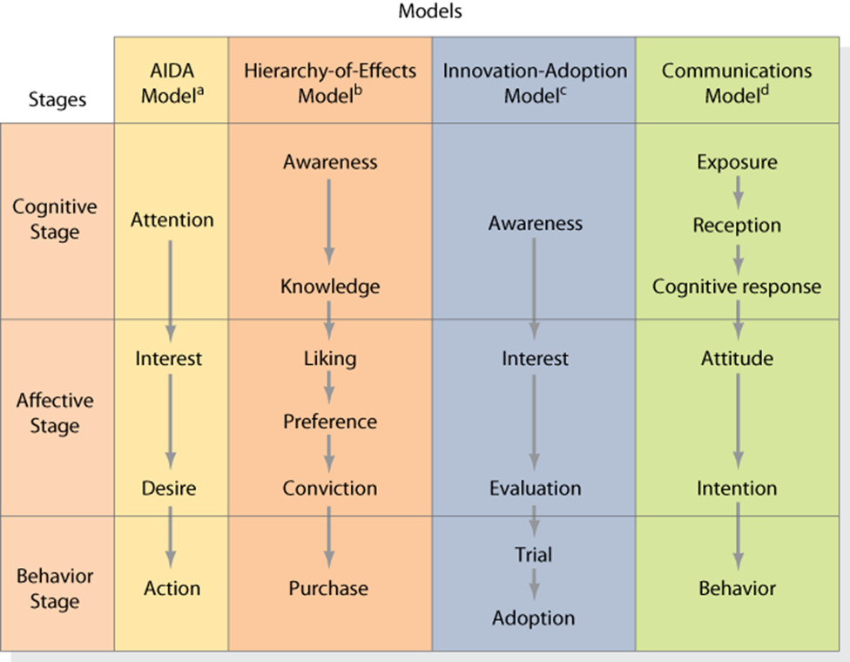
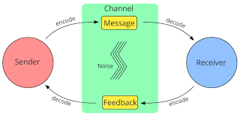
Communications Process Models
Macromodel
Micromodel
Goal 2 Understand the process and goals of integrated marketing communications.

Slide 5
Developing Effective Communications
The basics
Identify target audience
Determine objectives
Design communications
Establish budget
Select channels
Goal 3: Learn the steps in developing effective marketing communications

Slide 6
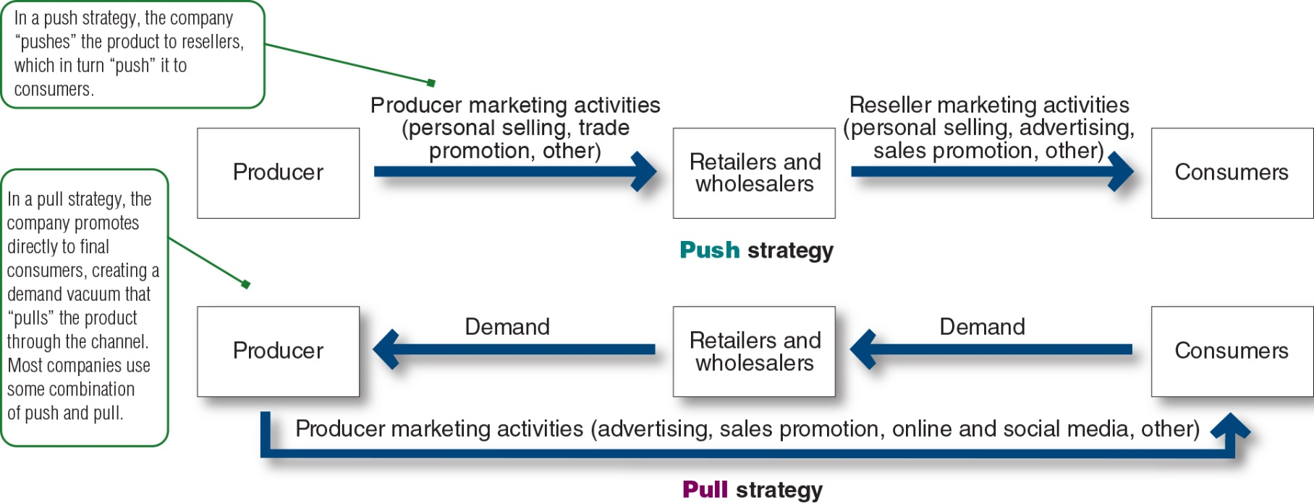
Push versus Pull Promotion Strategy
Notes:
This figure contrasts the two basic promotion mix strategies: push promotion versus pull promotion. The relative emphasis given to the specific promotion tools differs for push and pull strategies.
A push strategy refers to a promotion strategy that calls for using the sales force and trade promotion to push the product through channels. The producer promotes the product to channel members that in turn promote it to final consumers.
A pull strategy refers to a promotion strategy that calls for spending a lot on consumer advertising and promotion to induce final consumers to buy the product, creating a demand vacuum that pulls the product through the channel.
Business-to-consumer companies pull more, putting more of their funds into advertising, followed by sales promotion, personal selling, and then public relations. Business-to-business marketers tend to push more, putting more of their funds into personal selling, followed by sales promotion, advertising, and public relations.

Slide 7
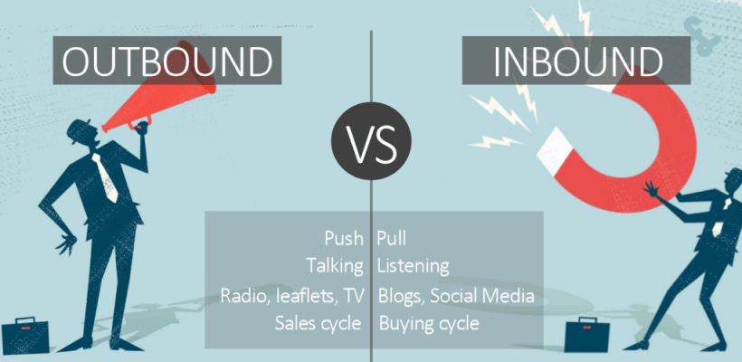
Another perspective
Inbound marketing is marketing in which customers initiate contact with the marketer in response to various methods used to gain their attention. These methods include email marketing, event marketing, content marketing and web design. In outbound marketing, the marketer initiates contact with the customer through methods such as TV, radio and digital display advertising. It is often used to influence consumer awareness and preference for a brand. (AMA)
Outbound marketing is a newer term for traditional marketing. That is why many marketing are recommending more use inbound marketing techniques.
Notes:
https://www.youtube.com/watch?v=4Y1y1-Xo1wc difference
https://www.youtube.com/watch?v=m-muJ6LlnVs&t=115s Hubspot

Slide 8
The components of the marketing communication mix
Goal 4: Understand the components of the marketing communication mix

Slide 9
1- Advertising
Any paid form of nonpersonal presentation and promotion of ideas, goods, or services by an identified sponsor via print media (newspapers and magazines), broadcast media (radio and television), network media (telephone, cable, satellite, wireless), electronic media (Web page), and display media (billboards, signs, posters).
Benefits/Pros, in general
Multipurpose (inform, remind, persuade)
Enhances a firm’s image/ Branding
Control of message
Repeatable
Cons:
Normally more costly
Credibility
Advertising all around us.
Goal 4: Understand the components of the marketing communication mix
Notes:
Advertising: Paid form of nonpersonal communication about an organization and its products transmitted to a target audience through mass media, such as television, radio, the Internet, newspapers, magazines, direct mail, outdoor displays, and signs on mass transit vehicles (PF)

Slide 10
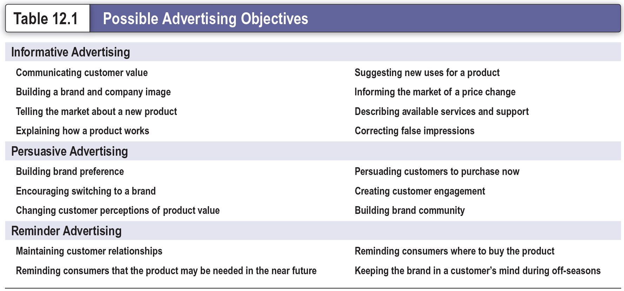
Possible Advertising Objectives
Notes:
An advertising objective is a specific communication task to be accomplished with a specific target audience during a specific period of time. Advertising objectives can be classified by their primary purpose which is, to inform, persuade, or remind. This table lists the examples of each of these specific objectives.
Informative advertising is used heavily when introducing a new product category. Persuasive advertising becomes more important as competition increases. And, reminder advertising is important for mature products; it helps to maintain customer relationships and keep consumers thinking about the product.

Slide 11
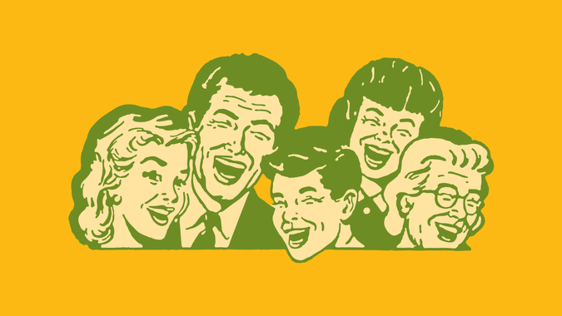
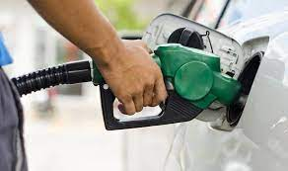
Funny ads. Why?
Notes:
Bonus: Super funny ads, Arabic or international, with brief discussion about it
Humor adds a handful of effective qualities to your marketing materials. At its best, humor is:
Attention-grabbing. Humor often stands out from other marketing and advertising attempts because it’s naturally colorful and original.
People love to spread laughter. Making your campaign humorous imbues it with more shareability.
Funny brands are more relatable and are seen as more trustworthy and human.
Humor is linked to higher recall, which means any message imbued with humor will be easier for your target demographics to remember.
The (Potential) Downside of Humor
However, at its worst, humor is:
The wrong joke at the wrong time can make your brand look amateurish and unprofessional.
If people think you’re cracking jokes for the sole purpose of getting more attention, you’ll be seen as exploitative rather than funny.
Humor can cheapen certain ideas or make them be taken less seriously.
In some cases, humor can be outright offensive. https://www.forbes.com/sites/steveolenski/2018/06/15/the-cmos-guide-to-using-humor-in-marketing/?sh=b889ac62bf73
https://www.youtube.com/watch?v=aKKcW7vuV2c&t=10s Pepsi coke
https://www.youtube.com/watch?v=kKzjkYqIguI top Egyptian valume
https://www.youtube.com/watch?v=R8JZIrQmgSc funny Egyptian Nescafe
https://www.youtube.com/watch?v=lVHRQSHoGgU top Kaliji English language
https://www.youtube.com/watch?v=eouWcUlcNzk old nice Saudi HASS
https://www.youtube.com/watch?v=T-tcwYwnexU funny Saudi

Slide 12
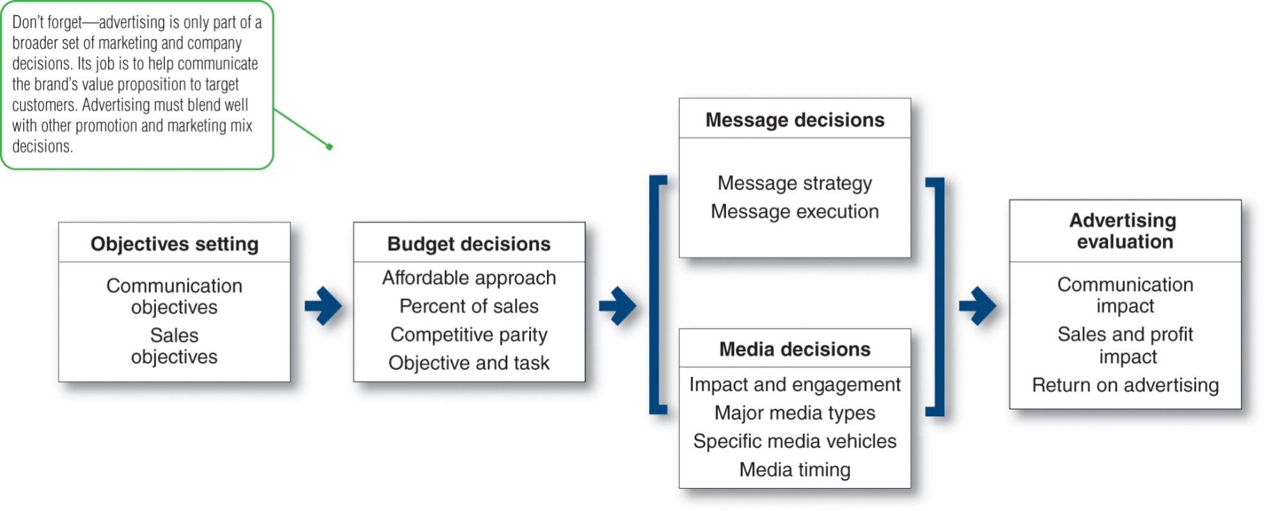
Major Advertising Decisions
Notes:
This figure shows the four important decisions made by marketing management when developing an advertising program. These decisions include setting advertising objectives, setting the advertising budget, developing advertising strategy, that is, message decisions and media decisions, and evaluating advertising campaigns.

Slide 13
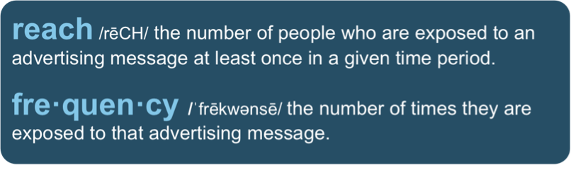
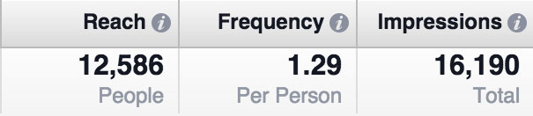
Selecting Advertising Media
Advertising media: Vehicles through which advertising messages are delivered to their intended audiences
Steps in advertising media selection:
Determining reach, frequency, impact
Choosing among major media types
Selecting specific media vehicles

Slide 14
Table 12.2 Profiles of Major Media Types (1 of 2)
Medium | Advantages | Limitations
Television | Good mass-marketing coverage; low cost per exposure; combines sight, sound, and motion | High absolute costs; high clutter; less audience selectivity
Digital, mobile, and social media | High selectivity; low cost; immediacy; engagement Capabilities | Potentially low impact; high audience control of content and exposure
Newspapers | Good local market coverage; high believability | Short life; small pass-along audience.
Direct mail | High audience selectivity; flexibility; no ad competition within the same medium; allows personalization | Relatively high cost per exposure; “junk mail” image.
Notes:
This table lists the advantages and limitations of the major media types: television, digital, mobile, and social media, newspapers, direct mail, magazines, radio, and outdoor.

Slide 15
Table 12.2 Profiles of Major Media Types (2 of 2)
Medium | Advantages | Limitations
Magazines | Credibility and prestige; high-quality reproduction; long life and good pass-along readership | High cost
Radio | Good local acceptance; low cost. | Audio only; low attention (“the half-heard” medium)
Outdoor | High repeat exposure; low cost; good positional selectivity | Little audience selectivity; creative limitations
Notes:
This table lists the advantages and limitations of the major media types: television, digital, mobile, and social media, newspapers, direct mail, magazines, radio, and outdoor.

Slide 16

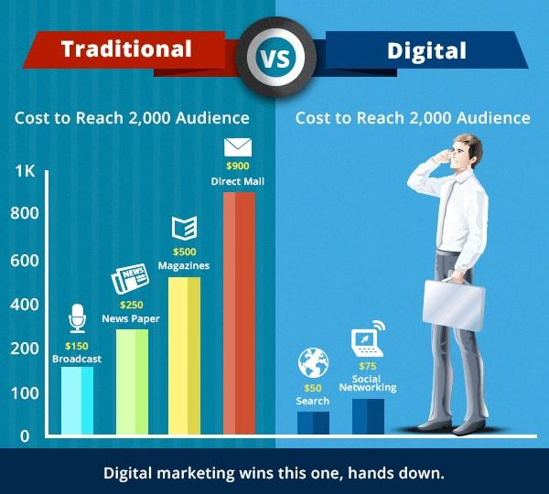
Notes:
Arab media
International media

Slide 17
2- Sales Promotion
Sales promotions are short-term incentives to encourage the purchase or sale of a product or service.
Can be targeted at final buyers, retailers and wholesalers, business customers, and members of the sales force.
The use of sales promotions has been growing rapidly.

Slide 18

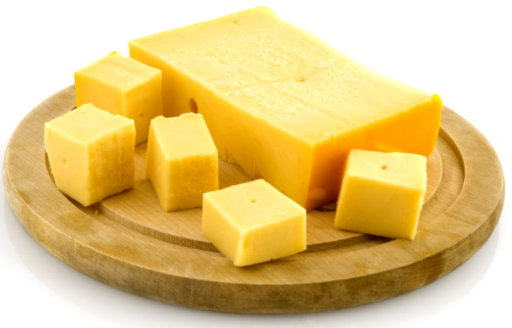


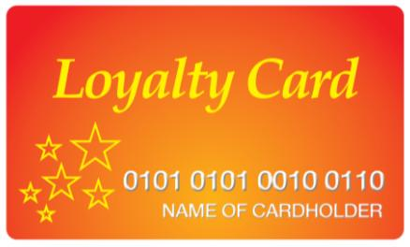

Objectives
Product trial
Increase repurchase
Reward
Brand switching
Notes:
Sellers use incentive-type promotions to attract new triers, to reward loyal customers, and to increase the repurchase rates of occasional users. Sales promotions often attract brand switchers, who are primarily looking for low price, good value, or premiums. If some of them would not have otherwise tried the brand, promotion can yield long-term increases in market share.

Slide 19
Major Consumer Promotion Tools
Samples/ Free Trials
Coupons
Cash Refund Offers (rebates)
Price Packs (2 for 1)
Premiums (gifts)
Frequency Programs
Prizes (contests, sweepstakes)
Product Warranties
Point-of-Purchase (P-O-P) Displays and Demonstrations
Notes:
Samples: Offer of a free amount of a product or service delivered door-to-door, sent in the mail,
picked up in a store, attached to another product, or featured in an advertising offer.
Coupons: Certificates entitling the bearer to a stated saving on the purchase of a specific product:
mailed, enclosed in other products or attached to them, or inserted in magazine and newspaper ads.
Cash Refund Offers (rebates): Provide a price reduction after purchase rather than at the retail
shop.
Price Packs (cents-off deals): Offers consumers savings off the regular price of a product
A reduced-price pack is a single package sold at a reduced price (such as two for the price of one).
A banded pack is two related products banded together (such as a toothbrush and toothpaste).
Premiums (gifts): Merchandise offered at a relatively low cost or free as an incentive to purchase
a particular product.
Frequency Programs: Programs providing rewards related to the consumer’s frequency and intensity in purchasing the company’s products or services.
Prizes (contests, sweepstakes): Prizes are offers of the chance to win cash, trips, or merchandise as a result of purchasing something. A contest calls for consumers to submit an entry to be examined by a panel of judges who will select the best entries. A sweepstakes asks consumers to submit their names in a drawing.
Product Warranties: Explicit or implicit promises by sellers that the product will perform as specified
or that the seller will fix it or refund the customer’s money during a specified period.
Point-of-Purchase (P-O-P) Displays and Demonstrations: P-O-P displays and demonstrations
take place at the point of purchase or sale.

Slide 20
3- Public Relations
Public is any group that has an actual or potential interest in or impact on a company’s ability to achieve its objectives.
Public relations (PR) includes a variety of programs to promote or protect a company’s image or individual products.
Basic rule of good PR: do something good, then talk about it. (SO)
Notes:
Many companies are turning to marketing public relations (MPR) to support corporate or product promotion and image making. MPR, like financial PR and community PR, serves a special constituency, the marketing department. The old name for MPR was publicity, the task of securing editorial space—as opposed to paid space—in print and broadcast media to promote a product, service, idea, place, person, or organization.

Slide 21
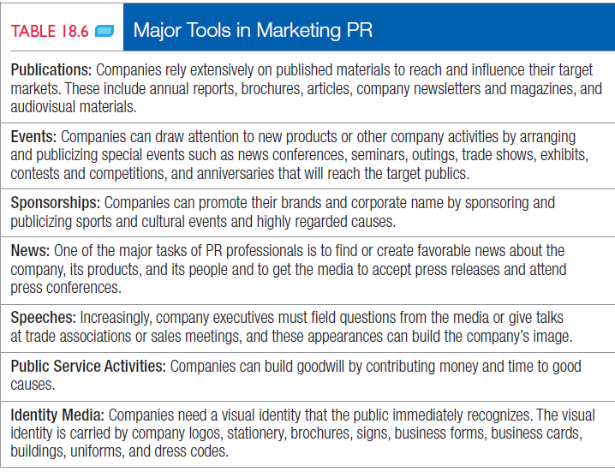

Slide 22
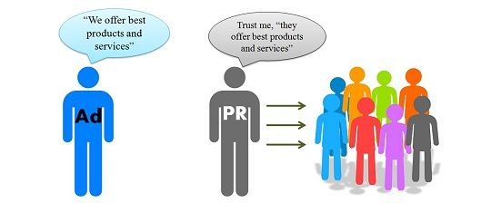
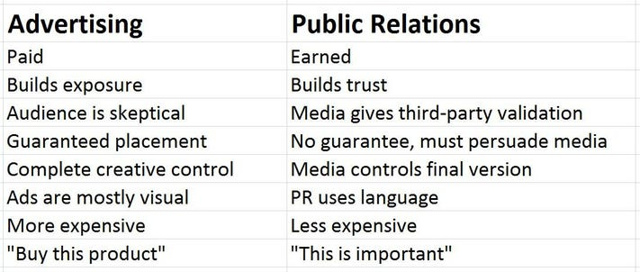
Notes:
https://www.forbes.com/sites/robertwynne/2014/07/08/the-real-difference-between-pr-and-advertising-credibility/?sh=e0edad22bb95

Slide 23
Marketing public relations (MPR)
Many companies are turning to marketing public relations (MPR) to support corporate or product promotion and image making. MPR, like financial PR and community PR, serves a special constituency, the marketing department. The old name for MPR was publicity, the task of securing editorial space—as opposed to paid space—in print and broadcast media to promote a product, service, idea, place, person, or organization.
Notes:
A news story type of communication transmitted through a mass medium at no charge (PF)
News release
A short piece of copy publicizing an event or a product
Feature article
A manuscript of up to 3,000 words prepared for a specific publication
Captioned photograph
A photo with a brief description of its contents
Press conference
A meeting used to announce major news events

Slide 24
4- Personal Selling/Sales force
A paid personal communication that seeks to inform customers and persuade them to purchase products in an exchange situation (PF)
Its main advantages are having greater impact on consumers and providing immediate feedback. While main limitations are: Expensive, labor intensive and time consuming
Salespeople Have Many Names
Agents
Sales Consultants
Sales Representatives
Account Executives
Goal 4: Understand the components of the marketing communication mix
Notes:
(Sales definition) A marketing approach that involves direct sales of goods and services to consumers through personal explanation and demonstrations, frequently in their home or place of work. (AMA)
(Retailing definition) The process whereby the firm responsible for production sells to the user, ultimate consumer, or retailer without intervening middlemen. (AMA)
Can be studied under the place/distribution channels variable where producers can use it in direct marketing channels or intermediaries can use it in non store retailing

Slide 25
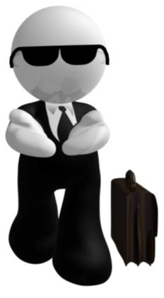
The Role of Personal Selling
so
Personal selling is more important:
when firm uses push strategy.
in B2B contexts.
with inexperienced consumers who need hands-on assistance.
for products bought infrequently (houses, cars, computers).
Notes:
1. Deliverer—A salesperson whose major task is the delivery of a product (water, fuel, oil).
2. Order taker—An inside order taker (standing behind the counter) or outside order taker (calling on the supermarket manager).
3. Missionary—A salesperson not permitted to take an order but expected rather to build goodwill or educate the actual or potential user (the medical “detailer” representing an ethical pharmaceutical house).
4. Technician—A salesperson with a high level of technical knowledge (the engineering salesperson who is primarily a consultant to client companies).
5. Demand creator—A salesperson who relies on creative methods for selling tangible products (vacuum cleaners, cleaning brushes, household products) or intangibles (insurance, advertising services, or education).

Slide 26
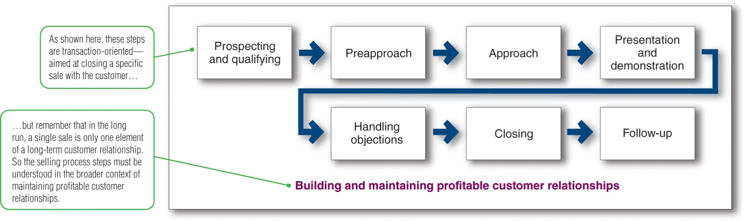
Steps in the Selling Process
Notes:
https://www.youtube.com/watch?v=PtJBVhkL1Eg selling is hard
https://www.youtube.com/watch?v=PT0bkGv8DDU&t=24s sales process
https://www.youtube.com/watch?v=e2ZXAhV8lzg is it bad
Figure 13.3 shows seven steps in the selling process.
The first step in the selling process is prospecting and qualifying—identifying qualified potential customers. They want to call on those who are most likely to appreciate and respond to the company’s value proposition—those the company can serve well and profitably.
Preapproach refers to a salesperson learning as much as possible about a prospective customer before making a sales call. During the approach step, the salesperson should know how to meet and greet the buyer and get the relationship off to a good start.
During the presentation and demonstration step of the selling process, the salesperson tells the “value story” to the buyer, demonstrating how the company’s offer solves the customer’s problems. In handling objections, the salesperson should use a positive approach, seek out hidden objections, ask the buyer to clarify any objections, take objections as opportunities to provide more information, and turn the objections into reasons for buying.
Closing refers to a salesperson asking the customer for an order. And finally, follow-up refers to a salesperson following up after the sale to ensure customer satisfaction and repeat business.

Slide 27
5- Direct and Digital Marketing
Engage directly with targeted consumers through digital and traditional methods to obtain an immediate response
Build lasting customer relationships, engagement, brand community, and sales
Digital methods are taking over
Notes:
Some sources address them together, some separately

Slide 28
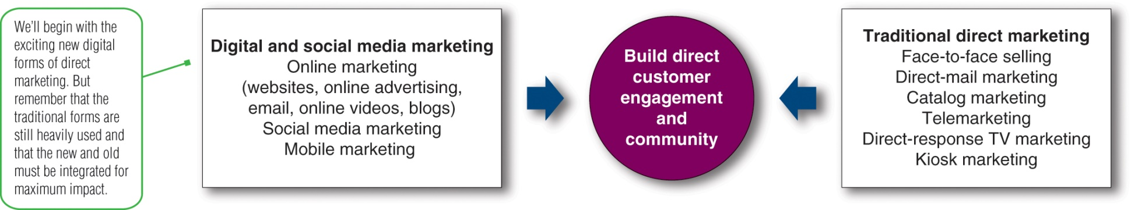
Forms of Direct and Digital Marketing
Notes:
This figure shows the major forms of direct and digital marketing.
Traditional direct marketing tools include face-to-face selling, direct-mail marketing, catalog marketing, telemarketing, direct-response television marketing, and kiosk marketing.
A dazzling new set of direct digital marketing tools has burst onto the marketing scene, including online marketing (Web sites, online ads and promotions, email, online videos, and blogs), social media marketing, and mobile marketing.

Slide 29
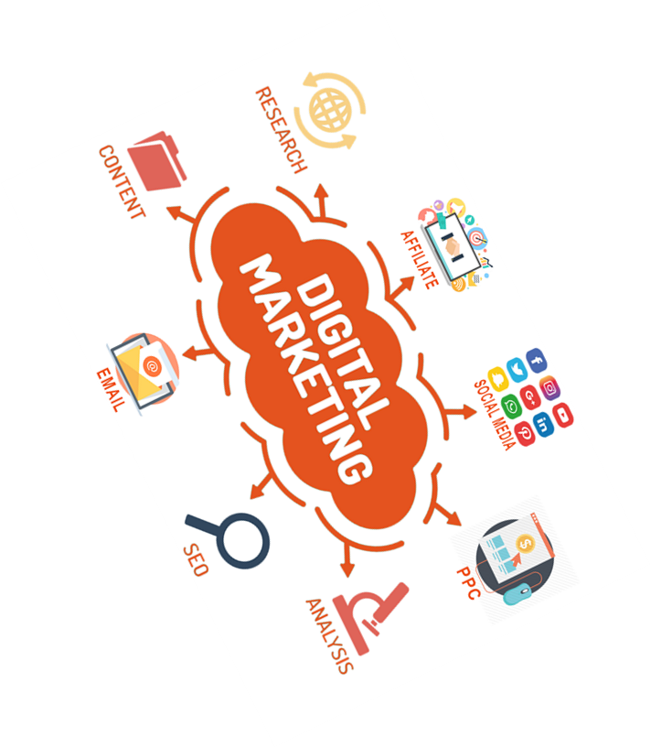
Rapid Growth of Digital Marketing (OR e-marketing)
Fastest-growing form of marketing
Direct marketing becoming more Internet-based
Direct marketing claims a surging share of marketing spending and sales
Includes online display and search advertising, video, social media, mobile, email
Notes:
Direct and digital marketing have become the fastest-growing form of marketing. Direct marketing continues to become more Internet-based, and digital direct marketing is claiming a surging share of marketing spending and sales. Total digital marketing spending—including online display and search advertising, video, social media, mobile, and email—now accounts for the largest share of media spending.

Slide 30
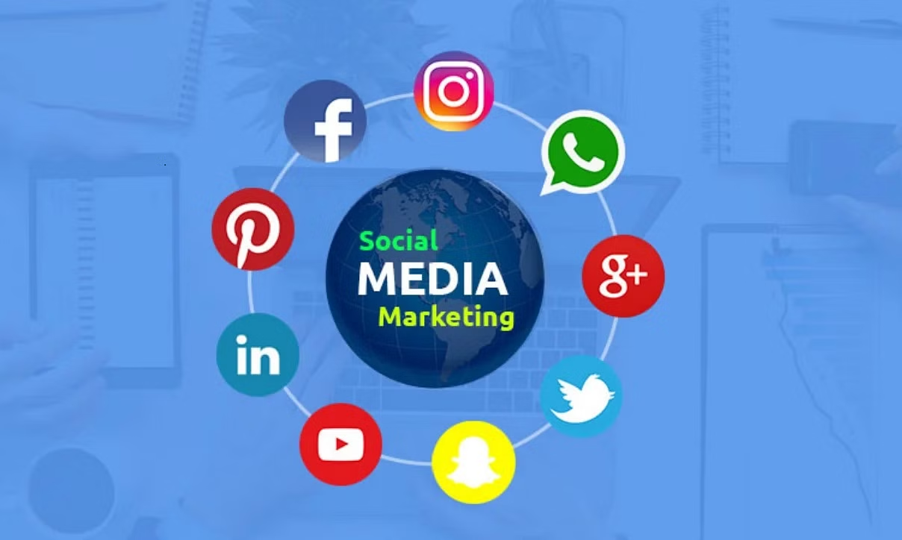
Social Media Marketing
Social media: Independent and commercial online communities where people congregate, to socialize and share messages, opinions, pictures, videos, and other content
Notes:
Social media are independent and commercial online communities where people congregate to socialize and share messages, opinions, pictures, videos, and other content. Marketers can engage in social media in two ways: They can use existing social media or they can set up their own. Using existing social media seems the easiest. Thus, most brands, large and small, have set up shop on a host of social media sites. Such social media can create substantial brand communities. Niche social media cater to the needs of smaller communities of like-minded people, making them ideal vehicles for marketers who want to target special interest groups.
Beyond these independent social media, many companies have created their own online brand communities. For example, in Nike’s Nike+ running community, members join together online to upload, track, and compare their performances.

Slide 31
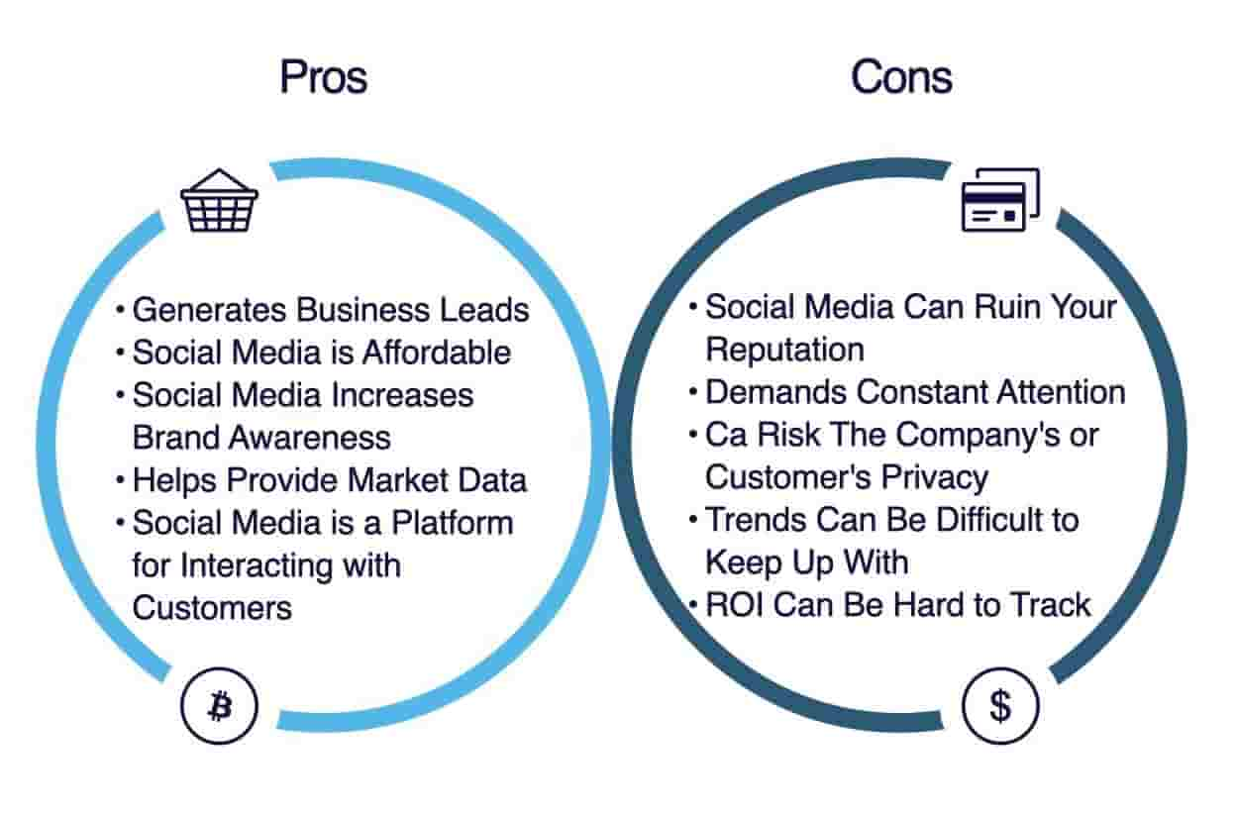
Social Media Marketing
Notes:
Using social media presents both advantages and challenges.
On the plus side, social media are targeted and personal, so they allow marketers to create and share tailored brand content with individual consumers and customer communities. Social media are interactive, making them ideal for starting and participating in customer conversations and listening to customer feedback. Social media are also immediate and timely. They can be used to reach customers anytime, anywhere with timely and relevant content regarding brand happenings and activities. Social media can be very cost effective. Although creating and administering social media content can be costly, many social media are free or inexpensive to use. The biggest advantages of social media are the engagement and social sharing capabilities. Social media are especially well suited to creating customer engagement and community.
Social media marketing also presents challenges. Most companies are still experimenting with how to use them effectively, and results are hard to measure. Social networks are largely user controlled. Marketers cannot simply muscle their way into consumers’ digital interactions—they need to earn the right to be there. Rather than intruding, marketers must learn to become a valued part of the online experience by developing a steady flow of engaging content.

Slide 32
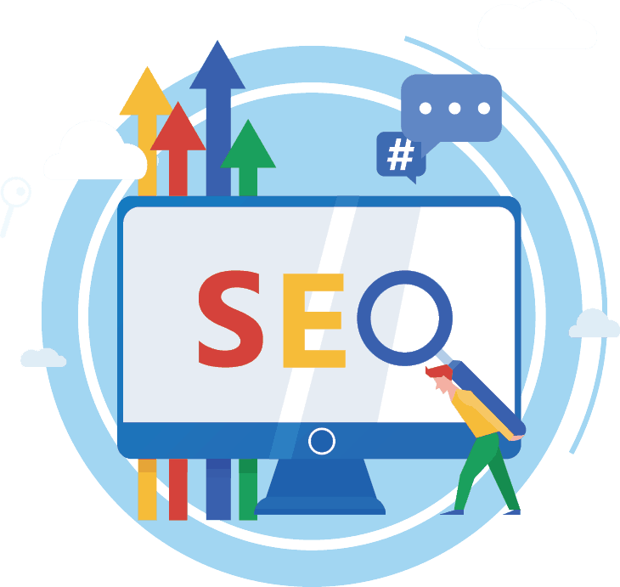
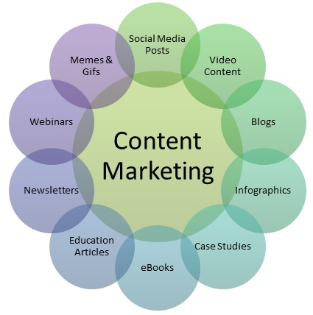
Search and Content marketing (AMA)
Search engine optimization is the process of developing a marketing/technical plan to improve visibility within one or more search engines. Typically, this consists of two elements.
Content Marketing: A technique of creating and distributing valuable, relevant and consistent content to attract and acquire a clearly defined audience—with the objective of driving profitable customer action.

Slide 33
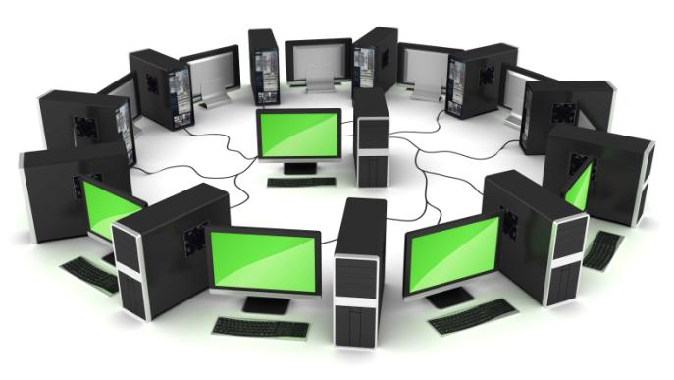
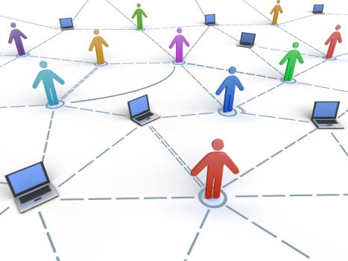
Word of Mouth: Social Media
Consumers use word of mouth to talk about dozens of brands each day, from media and entertainment products such as movies, TV shows, and publications to food products, travel services, and retail stores.
Notes:
Social networks have become an important force in both business-to-consumer and business-to-business marketing. Major ones include Facebook, which is the world’s biggest;MySpace, which concentrates on music and entertainment; LinkedIn, which targets career-minded professionals; and Twitter, which allows members to network via 140-character messages or “tweets.” Different networks offer different benefits to firms. For example, Twitter can be an early warning system that permits rapid response, whereas Facebook allows deeper dives to engage consumers in more meaningful ways
Online communities and forums come in all shapes and sizes. Many are created by consumers or groups of consumers with no commercial interests or company affiliations. Others are sponsored by companies whose members communicate with the company and with each other through postings, instant messaging, and chat discussions about special interests related to the company’s products. Apple hosts a large number of discussion groups organized by product lines and also by consumer versus professional use. These groups are customers’ primary source of product information after warranties expire.

Slide 34
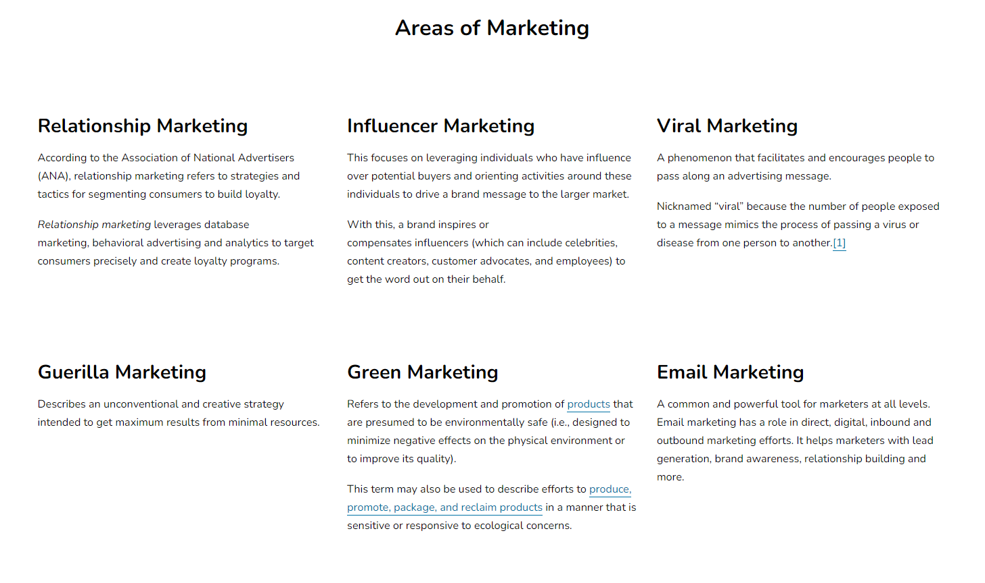
Think?? Areas of marketing on AMA main website
Notes:
https://www.ama.org/the-definition-of-marketing-what-is-marketing/#:~:text=A%20technique%20of%20creating%20and,of%20driving%20profitable%20customer%20action.
Which are more into promotion (MC)?
Many, which shows that promotion an important and the most constantly changing elements in the mix

